Slide 1
Inferred Models for Dynamic and Sparse Hardware-Software Spaces
Weidan Wu, Benjamin C. Lee
Duke University

Slide 2
Mapping Software to Hardware
N
Heterogeneous HW
Diverse SW
M
A HW-SW Mapping
Management space explosion (M x N)

Slide 3
Inference with Sparse Profiles
HW→
System Management Space
SW→

Slide 4
Integrated HW & SW Analysis
Lays a foundation for run-time management
Increases diversity among sparse samples
Prior work separates HW & SW
HW→
SW→
System Management Space

Slide 5
Principles and Strategies
Enhance data re-usability
Shard-level profiles
Portable characteristics (μ-arch independent)
Automate modeling
Genetic algorithm trains, updates models
Accommodates dynamic systems

Slide 6
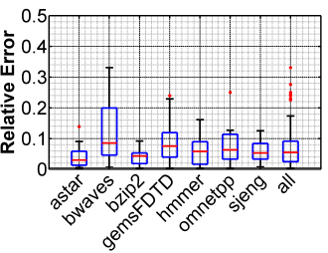
Accurate Extrapolation
Predict performance for new HW-SW pairs with 5-10% median error

Slide 7
Inferred Models for Dynamic and Sparse Hardware-Software Spaces
Weidan Wu, Benjamin C. Lee
Duke University

