Slide 1
Predicting Performance Impact of DVFS for Realistic Memory Systems
Rustam Miftakhutdinov
Eiman Ebrahimi
Yale N. Patt

Slide 2
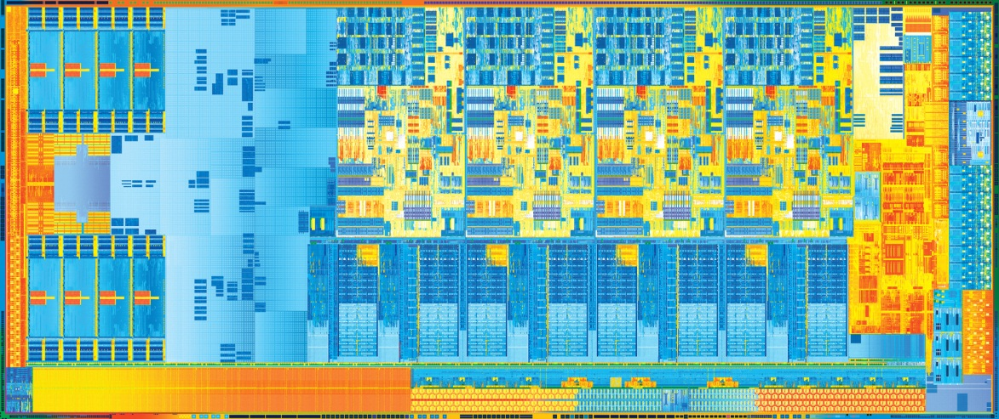
Dynamic Voltage/Frequency Scaling
V
f
Image source: intel.com

Slide 3
Impact of Frequency Scaling
time
energy
power
f_{opt}
frequency

Slide 4
Impact of Frequency Scaling
time
power
f_{o}
frequency

Slide 5
Prediction Overview
our work
time
energy per
instruction
energy
f_{o}
freq.
×
f_{opt}
f_{o}
f_{opt}
freq.
frequency
f_{o}
power
f_{o}
freq.
0
100K
200K
300K
instructions

Slide 6
Outline
✓
Intro to performance prediction
Why realistic memory systems?
Variable memory latency
Prefetching

Slide 7
Why Realistic Memory System?
V
f

Slide 8
Prior Work
Stall time
Leading loads (2010)
S. Eyerman et al.
G. Keramidas et al.
B. Rountree
Evaluated with constant access latency memory system

Slide 9
Energy Savings
*
Gmean of relative savings for 13 memory-intensive SPEC 2006 benchmarks. Baseline: most energy-efficient static frequency for SPEC 2006

Slide 10
Energy Savings
*
Gmean of relative savings for 13 memory-intensive SPEC 2006 benchmarks. Baseline: most energy-efficient static frequency for SPEC 2006

Slide 11
Outline
✓
Intro to performance prediction
Why realistic memory systems?
Variable memory latency
Prefetching
✓

Slide 12
Execution Example
C
memory
requests
B
D
A
E
chip
activity
1
2
3
4
time

Slide 13
T = T_{memory} + T_{compute}
independent of frequency
proportional to cycle time

Slide 14
Linear Model
execution time T
T_{compute}
T_{memory}
t_{o}
0
cycle time t

Slide 15
Measuring T_{memory}
memory
requests
chip
activity
time

Slide 16
Measuring T_{memory}
memory
requests
chip
activity
time

Slide 17
Causes of Request Dependences
Pointer Chasing
Finite Chip Resources
next
miss
miss
next
instruction window
next

Slide 18
Measuring T_{memory}
memory
requests
chip
activity
time

Slide 19
Critical Path Algorithm
new T_{memory}
T_{memory}
(length of critical path)
T_{start}
T_{end}
time
at T_{start} 1. record T_{start} and T_{memory}
old critical path
request latency
at T_{end} 2. compute path = T_{memory}(T_{start}) + (T_{end} - T_{start})
3. set T_{memory} = max(T_{memory}, path)

Slide 20
Linear Model
execution time T
T_{compute}
T_{memory}
t_{o}
0
cycle time t

Slide 21
Linear Model
execution time T
time
time
T_{m}
t_{o}
cycle time
f_{o}
freq.
T_{compute}
energy
×
T_{memory}
f_{o}
f_{opt}
freq.
power
t_{o}
0
cycle time t
f_{o}
freq.

Slide 22
Critical Path: Variable Access Latency
memory
requests
chip
activity
time
Leading Loads: Constant Access Latency
memory
requests
chip
activity
time

Slide 23
Leading Loads
execution time T
leading loads
T_{compute}
T_{memory}
t_{o}
0
cycle time t

Slide 24
Leading Loads
execution time T
time
time
leading loads
T_{m}
t_{o}
cycle time
f_{o}
freq.
T_{compute}
energy
×
T_{memory}
f_{o}
f_{opt}
freq.
power
t_{o}
0
cycle time t
f_{o}
freq.

Slide 25
Energy Savings
*
Gmean of relative savings for 13 memory-intensive SPEC 2006 benchmarks. Baseline: most energy-efficient static frequency for SPEC 2006

Slide 26
Outline
✓
Intro to performance prediction
Why realistic memory systems?
Variable memory latency
Prefetching
✓
✓

Slide 27
Streaming Workload
Prefetcher OFF
memory
requests
chip
activity
time
Prefetcher ON
memory
requests
chip
activity
time
Prefetcher ON Frequency +200 MHz
memory
requests
chip
activity
time
Prefetcher ON Frequency +500 MHz
memory
requests
chip
activity
time

Slide 28
Limited Bandwidth Model
execution time T
T_{memory}
^{min}
T_{compute}
T_{demand}
0
t_{crossover}
cycle time t

Slide 29
Energy Savings
*
Gmean of relative savings for 13 memory-intensive SPEC 2006 benchmarks. Baseline: most energy-efficient static frequency for SPEC 2006

Slide 30
Recap
✓
Intro to performance prediction
Why realistic memory systems?
Variable memory latency
Prefetching
✓
✓
✓

Slide 31
Final Thought
Performance predictors need realistic evaluation

