Slide 1
SLICC Self-Assembly of Instruction Cache Collectives for OLTP Workloads
Islam Atta
Andreas Moshovos
Pınar Tözün
Anastasia Ailamaki

Slide 2
Online Transaction Processing (OLTP)
$100 Billion/Yr, +10% annually
E.g., banking, online purchases, stock market…
Benchmarking
Transaction Processing Council
TPC-C: Wholesale retailer
TPC-E: Brokerage market
OLTP drives innovation for HW and DB vendors

Slide 3
Transactions Suffer from Instruction Misses
Many concurrent transactions
Each
L1-I
size
Footprint
Time
Instruction Stalls due to L1 Instruction Cache Thrashing

Slide 4
Even on a CMP all Transactions Suffer
Cores
L1-1 Caches
Time
Transactions
All caches thrashed with similar code blocks

Slide 5
Opportunity
Technology:
CMP’s aggregate L1 instruction cache capacity is large enough
Application Behavior:
Instruction overlap within and across transactions
Multiple L1-I caches
Time
Multiple threads
Footprint over Multiple Cores → Reduced Instruction Misses

Slide 6
SLICC Overview
Dynamic Hardware Solution
How to divide a transaction
When to move
Where to go
Performance
Reduces instruction misses by 44% (TPC-C), 68% (TPC-E)
Performance improves by 60% (TPC-C), 79% (TPC-E)
Robust:
non-OLTP workload remains unaffected

Slide 7
Talk Roadmap
Intra/Inter-thread instruction locality is high
SLICC Concept
SLICC Ingredients
Results
Summary

Slide 8
OLTP Facts
Many concurrent transactions
Few DB operations
28 – 65KB
Few transaction types
TPC-C: 5, TPC-E: 12
Transactions fit in 128-512KB
R()
U()
I()
D()
IT()
ITP()
New Order
Payment
Overlap within and across different transactions
CMPs’ aggregate L1-I cache is large enough

Slide 9
Instruction Commonality Across Transactions
TPC-C
TPC-E
All Threads
Most
Few
Single
Per Transaction
Type
More Yellow
More Reuse
Lots of code reuse
Even higher across same-type transactions

Slide 10
Requirements
Enable usage of aggregate L1-I capacity
Large cache size without increased latency
Exploit instruction commonality
Localizes common transaction instructions
Dynamic
Independent of footprint size or cache configuration

Slide 11
Talk Roadmap
Intra/Inter-thread instruction locality is high
SLICC Concept
SLICC Ingredients
Results
Summary

Slide 12
Example for Concurrent Transactions
Transactions
Control Flow
Graph
T1
T2
T3
Code segments that can fit into L1-I

Slide 13
Scheduling Threads
Threads
Conventional
SLICC
T1
CORES
CORES
0
1
2
3
0
1
2
3
T1
L1-I
T1
T1
T1
T2
T1
T2
T2
T1
Time
T1
T2
T3
T3
T2
T1
T1
T2
T1
T1
T2
T3
T3
T1
T2
T3
T1
T2
T2
T3
T3
T3
T3
Cache Filled 10 times
Cache Filled 4 times

Slide 14
Talk Roadmap
Intra/Inter-thread instruction locality is high
SLICC Concept
SLICC Ingredients
Results
Summary

Slide 15
Migration Ingredients
When to migrate?
Step 1:
Detect: cache full
Step 2:
Detect: new code segment
Where to go?
Step 3:
Predict where is the next code segment?

Slide 16
Migration Ingredients
Idle cores
When to migrate?
Step 1:
Detect: cache full
Step 2:
Detect: new segment
Where to go?
Step 3:
Where is the next segment?
Loops
Time
Return back
Idle
T1

Slide 17
Migration Ingredients
When to migrate?
Step 1:
Detect: cache full
Step 2:
Detect: new segment
Where to go?
Step 3:
Where is the next segment?
Time
T2

Slide 18
Implementation
When to migrate?
Step 1:
Detect: cache full
Step 2:
Detect: new segment
Where to go?
Step 3:
Where is the next segment?
Miss Counter
Miss Dilution
Find signature blocks on remote cores

Slide 19
Boosting Effectiveness
More overlap across transactions of the same-type
SLICC: Transaction Type-oblivious
Transaction Type-aware
SLICC-Pp: Pre-processing to detect similar transactions
SLICC-SW : Software provides information

Slide 20
Talk Roadmap
Intra/Inter-thread instruction locality is high
SLICC Concept
SLICC Ingredients
Results
Summary

Slide 21
Experimental Evaluation
How does SLICC affect INSTRUCTION misses?
→ Our primary goal
How does it affect DATA misses?
→ Expected to increase, by how much?
Performance impact:
→ Are DATA misses and MIGRATION OVERHEADS amortized?

Slide 22
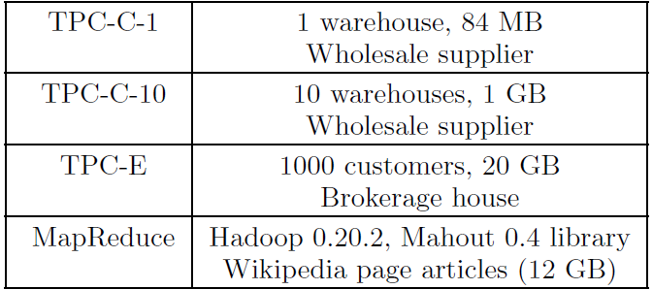
Methodology
Simulation
Zesto (x86)
16 OoO cores, 32KB L1-I, 32KB L1-D, 1MB per core L2
QEMU extension
User and Kernel space
Workloads
Shore-MT

Slide 23
Effect on Misses
Baseline: no effort to reduce instruction misses
I-MPKI
Better
D-MPKI
Reduce I-MPKI by 58%. Increase D-MPKI by 7%.

Slide 24
Performance
Next-line: always prefetch the next-line
Upper bound for Proactive Instruction Fetch [Ferdman, MICRO’11]
Next-Line
PIF-No Overhead
SLICC
SLICC-SW
Better
Storage per core
- PIF: ~40KB
- SLICC: <1KB.
TPC-C: +60% TPC-E: +79%

Slide 25
Summary
OLTP’s performance suffers due to instruction stalls.
Technology & Application Opportunities:
Instruction footprint fits on aggregate L1-I capacity of CMPs.
Inter- and intra-thread locality.
SLICC:
Thread migration → spread instruction footprint over multiple cores.
Reduce I-MPKI by 58%
Improve performance by
Baseline: +70%
Next-line: +44%
PIF: ±2% to +21%

Slide 26
Thanks!

Slide 27
Why data misses increase?
Example: thread migrates from core A → core B.
Read data on core B that is fetched on core A.
Write data on core B to invalidate data on core A.
When returning to core A, cache blocks might be evicted by other threads.

Slide 28
SLICC Agent per Core

Slide 29
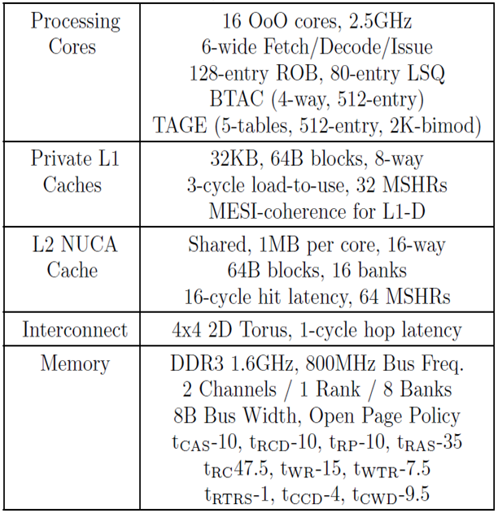
Detailed Methodology
Zesto (x86)
Qtrace (QEMU extension)
Shore-MT

Slide 30
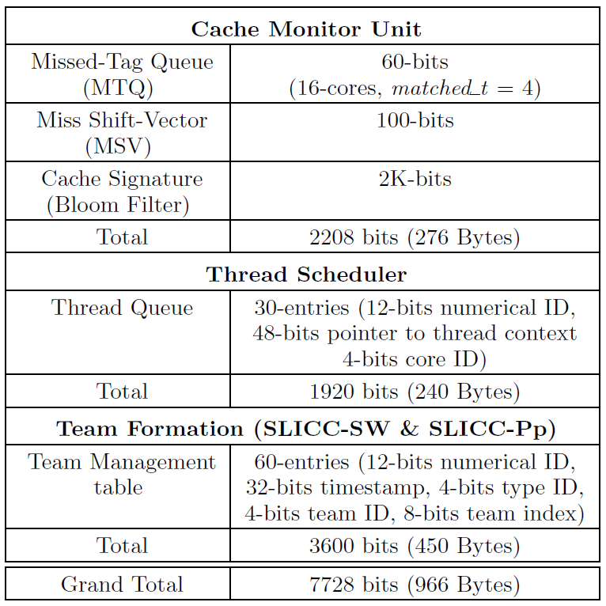
Hardware Cost

Slide 31
Larger I-caches?
Better
Better

Slide 32
Different Replacement Policies?
Better

Slide 33
Parameter Space (1)
Better
Better

Slide 34
Parameter Space (2)
Better
Better

Slide 35
Cache Signature Accuracy
Partial Bloom Filter
Better

