Slide 1
Inferred Models for Dynamic and Sparse Hardware-Software Spaces
Weidan Wu, Benjamin C. Lee
Duke University

Slide 2
Trends in Management & Diversity
Increasingly Sophisticated Management
Allocate resources, schedule applications, …
Understand HW-SW interactions
Increasingly Diverse HW & SW
Heterogeneous cores, VMs, contention, …
Diverse clients, jobs, tasks, …

Slide 3
Mapping Software to Hardware
N
Heterogeneous HW
Diverse SW
M
A HW-SW Mapping
Management space explosion (M x N)

Slide 4
Profilers Support Management
HW→
System Management Space
But profile sparsity increases with diversity
SW→
Sparse Samples

Slide 5
Inference with Sparse Profiles
HW→
System Management Space
SW→

Slide 6
Outline
Introduction
Inferred Performance Models
Generalized Models
Specialized Models
Conclusions

Slide 7
Inferred Performance Models
Models, predictions support management
HW→
System Management Space
Model
SW→

Slide 8
Integrated HW & SW Analysis
Lays a foundation for run-time management
Increases diversity among sparse samples
Prior work separates HW & SW
HW→
SW→
System Management Space

Slide 9
New Challenges
Larger space, greater sparsity
Data re-usability is critical
30 parameters → 5E+15 points
Less structured training data
SW profiles from arbitrary, real shards
HW profiles from defined, simulated design space

Slide 10
Principles and Strategies
Enhance data re-usability
Shard-level profiles
Portable characteristics (μ-arch independent)
Automate modeling
Genetic algorithm
Mitigate space explosion

Slide 11
Shard-level Profiles
Shards: short dynamic instruction segments
Re-use data among applications
New shards resemble existing ones
Monolithic profiles only useful when entire application resembles existing one
A Shard

Slide 12
Shard-level Profiles
Shards are sparse, randomly sampled segments of 10M instructions
Shards from diverse applications complement each other, reducing profiling costs
Shards expose intra-application diversity

Slide 13
Portable Characteristics
Re-use data among microarchitectures
Microarchitecture-independent measures
Ex: instruction mix versus cache miss rate
Existing SW profiles relevant for new HW

Slide 14
Sharing Supports Inference
Shards enhances data re-use across SW
Portability enhances data re-use across HW
Inferred models require less training data due to enhanced re-use

Slide 15
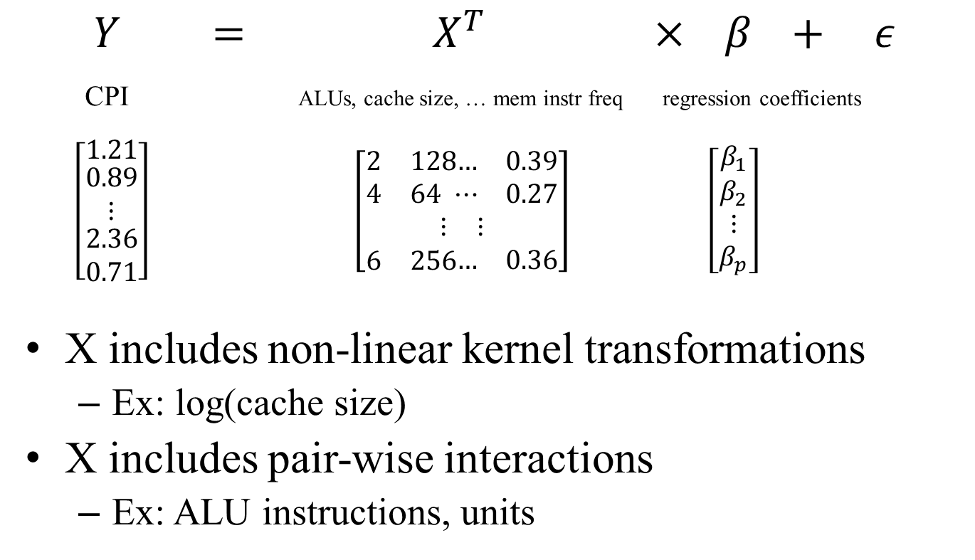
Statistical Inference
$$Y = { X}^{T} × β + ε$$
CPI ALUs, cache size, … mem instr freq regression coefficients
$\left[\begin{matrix}1.21 \\ \begin{aligned}0.89 \\ ⋮ \\ \begin{matrix}2.36 \\ 0.71\end{matrix}\end{aligned}\end{matrix}\right] \left[\begin{aligned}\begin{matrix}2 & 128\end{matrix}\begin{matrix}… & 0.39\end{matrix} \\ \begin{matrix}4 & 64\end{matrix}\begin{matrix} ⋯ & 0.27\end{matrix} \\ \begin{matrix}⋮ & ⋮\end{matrix} \\ \begin{matrix}6 & 256\end{matrix}\begin{matrix}… & 0.36\end{matrix}\end{aligned}\right] \left[\begin{aligned}\begin{matrix}β_{1} \\ β_{2}\end{matrix} \\ ⋮ \\ β_{p}\end{aligned}\right]$
X includes non-linear kernel transformations
Ex: log(cache size)
X includes pair-wise interactions
Ex: ALU instructions, units

Slide 16
Space of Model Specifications
Many kernel transformations
log, power, cubic spline, exponential, sqrt…
30 parameters, 5 kernels → $5^{30}$model specs
Many parameter interactions
Hardware and software interact
$\left(\begin{matrix}30 \\ 2\end{matrix}\right)$ = 435 pairwise interactions → $2^{435}$ specs

Slide 17
Automatic Model Construction
Genetic Algorithm
Model (kernels, interactions)
Training Data
Model specification encoded as genes
Mutation, crossover search models
Selection evolves model toward higher accuracy

Slide 18
Automatic Model Updates
New Training Data
Genetic Algorithm
Model (kernels, interactions)
Old Model
New data updates model specification
Algorithm changes kernels, interactions, fit

Slide 19
Outline
Introduction
Inferred Performance Models
Generalized Models
Specialized Models
Conclusions

Slide 20
Generalized Models
Diverse SW as applications enter/leave system
Ex: democratized datacenter computing
Heterogeneous HW as architectures tuned
Ex: big/small cores, VMs, contention, …
Profiled data collected as SW runs on HW
Models update to accommodate dynamics

Slide 21
Inductive Hypothesis
System in steady state
Accurate model is trained M(H,S)
Manager uses model predictions
model
system manager
scheduling

Slide 22
Inductive Step
System is perturbed with new SW or HW
Profile new SW-HW, check prediction
System Manager
Yes
Still in Steady State
Accurate ?
Model
No
New application
Update

Slide 23
Model Updates
Poor prediction triggers model update
Collect a few profiles for new SW (e.g., 10-20)
Update kernels, interactions, fit
Genetic Algorithm
New Training Data
Model (Kernels, Interactions)
Old Model

Slide 24
Integrated HW & SW Space
Hardware Space (17 parameters)
Pipeline parameters → e.g. width, rob size
Cache parameters → e.g., cache size, associativity
Functional unit → e.g., ALU count
Software Space (13 parameters)
Instruction mix
Locality → e.g., re-use distance
ILP → e.g., producer-consumer distance

Slide 25
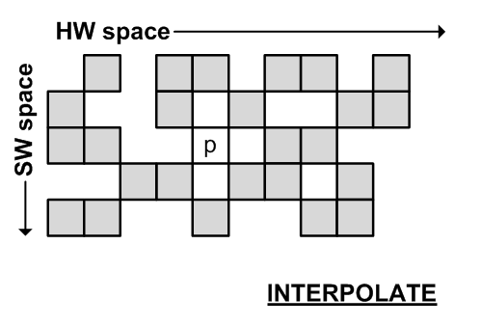
Steady State Interpolation
Train model with sparse HW-SW profiles
Interpolate for HW-SW pairs not profiles

Slide 26
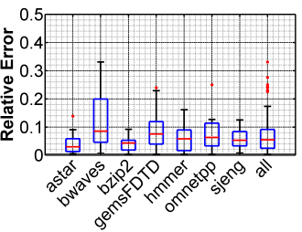
Perturbed Extrapolation
Train model with sparse HW-SW profiles
Extrapolate for new SW and new HW
Predict app n from n-1 apps
Also supports SW variants (compiler opt, data inputs)

Slide 27
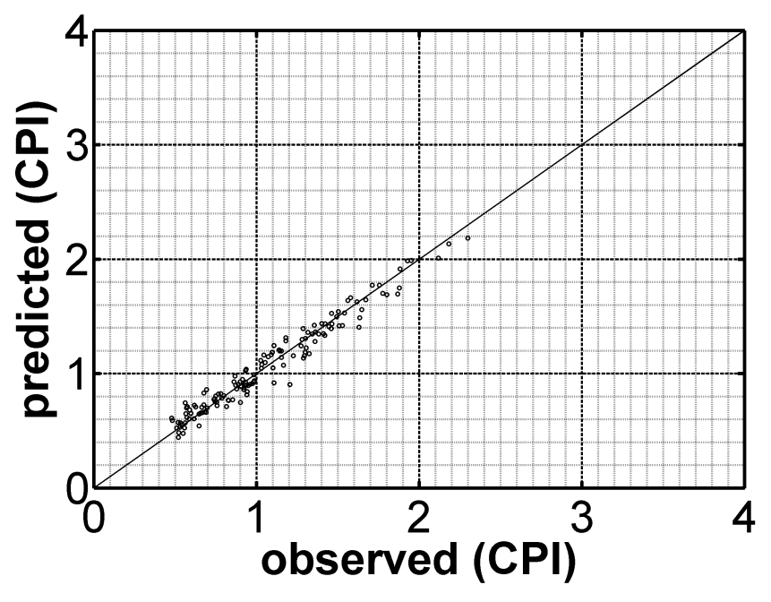
Relative Accuracy
Accurate interpolation, extrapolation
Correlation coefficient > 0.9

Slide 28
Outline
Introduction
Inferred Performance Models
Generalized Models
Specialized Models
Conclusions

Slide 29
Specialized Models
Generality is expensive
Requires many SW characteristics (e.g,. 13)
With domain knowledge, SW behavior expressed at higher level
Reduces number of SW characteristics
Reduces profiling cost
Increases model accuracy

Slide 30
Sparse Matrix-Vector Multiply
Compute y=Ax+b when A is sparse, blocked
SW space → block row, block column, fill ratio
HW space → cache

Slide 31
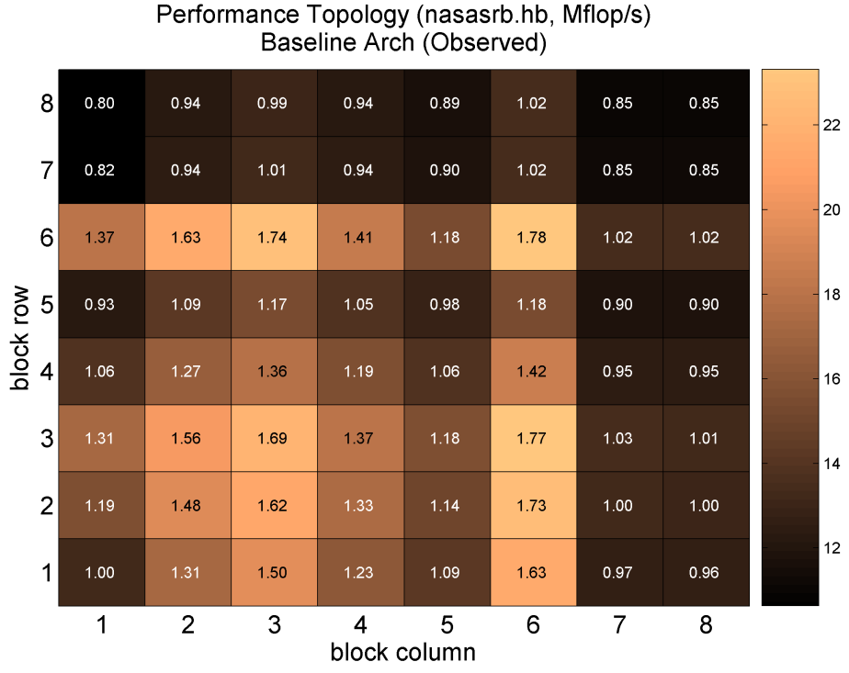
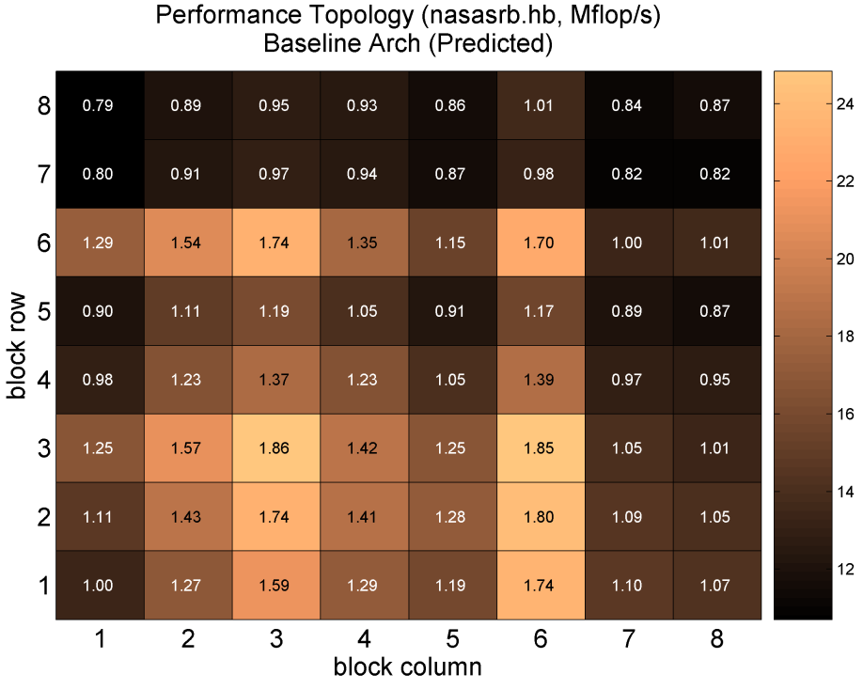
SpMV Model Accuracy
Models irregular performance caused by fill ratios
True performance
Predictive performance
Notes:
Separate two figures

Slide 32
Also in the paper…
Shard-level prediction
Basis of application prediction
Genetic algorithm evaluation
Convergence versus model accuracy
Coordinated optimization for SpMV
Optimize HW and software
Optimize performance and power

Slide 33
Conclusions
Present framework to close data-to-decision gap
Infer performance from huge, sparse data
Automate modeling in dynamic managers
Apply domain knowledge for concise models

Slide 34
Inferred Models for Dynamic and Sparse Hardware-Software Spaces
Weidan Wu, Benjamin C. Lee
Duke University

